Slide 1

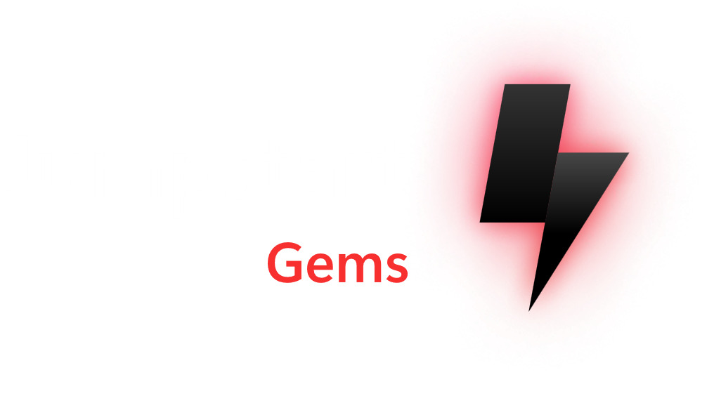


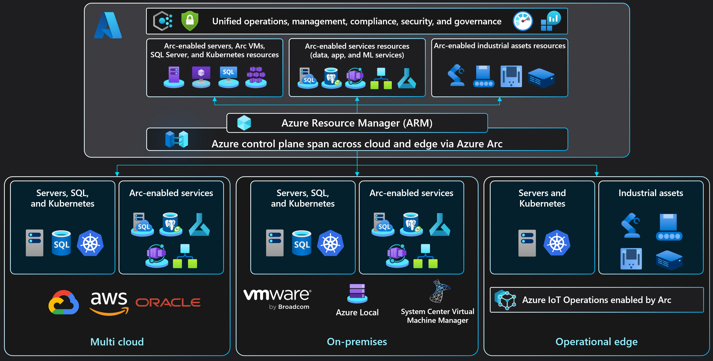





































Azure Arc-enabled Kubernetes
Azure Arc solution architecture
Cluster onboarding workflow architecture
Connected cluster management architecture
Cluster admin
3f
Create Service Principal in Microsoft Entra ID
Fetch the identity certificate
5b
Cluster admin
1
1
Microsoft
Entra ID
Managed Identity service
Prepare prerequisites for onboarding Arc-enabled Kubernetes
Microsoft Container Registry
Azure Monitor
Onboard cluster
3d
Create Managed Identity
3e
4
Azure CLI and Azure PowerShell
PUT resource Microsoft.Kubernetes/connectedClusters with public key (management.azure.com)
Azure Resource Manager (ARM)
Save identity metadata
Hybrid Identity service
Arc-enabled Kubernetes onboarding Interfaces
Arc-enabled Kubernetes cluster resource
7
Fetch Helm chart
Microsoft.Kubernetes
resource provider
Azure portal
Arc-enabled Kubernetes Connect Service
Query Log Analytics workspace for issues and raise alerts
Azure Log Analytics Workspace
2
Microsoft Container Registry
Update cluster metadata
Arc-enabled Kubernetes Data Plane service
PowerShell
Kubernetes Config Service
PUT connectedCluster resource
along with Managed Identity metadata
3g
6d
6c
Azure CLI
5
6
Pull agent images
3c
Push cluster metadata (uses Managed Identity to authenticate eastus.dp.kubernetesconfiguration.com)
Azure REST API
Install Arc-enabled Kubernetes cluster extensions using the k8s-extension command
Pull Azure Arc-enabled Kubernetes helm charts and agent images and deploy agent pods
Update connected cluster status using heartbeat
Push Arc-enabled Kubernetes cluster logs and metrics to Azure Log Analytics workspace
Arc-enabled Kubernetes cluster
kubectl
3
4
3a
6a
Fetch cluster metadata and update custom resource
Cluster Metadata operator
2
Onboard Kubernetes cluster to Arc the using connectedk8s command
Uses Helm to deploy Arc-enabled Kubernetes agents with onboarding private key
Kubernetes API server
6b
Watch for updates in cluster
metadata custom resource
Arc-enabled Kubernetes cluster
Save state and onboarding private key in Kubernetes datastore
Resource Sync operator
5a
API server
Arc-enabled Kubernetes agent tree
Arc-enabled Kubernetes cluster extensions (Azure Policy, Microsoft Defender for Cloud, Flux, Azure Monitor, Azure Key Vault, etc.)
etcd
3b
5c
Save the Azure identity certificate
Cluster Identity Operator
Fetch connectedCluster Managed Identity certificate
(uses onboarding private key to authenticate eus.his.azure.com)
Network connectivity architecture
Cluster Connect network architecture
Cluster extension installation workflow architecture
SaaS Git services (i.e GitHub, Azure DevOps)
Any network location
HTTPs 443
Microsoft Entra ID
Cluster admin
6
GET version
Microsoft Entra ID
Azure Resource Manager (ARM)
Azure Virtual Network
Cluster admin
Microsoft Entra ID authentication and authorization with Conditional Access Policies
HTTPs 443
Azure Resource Manager (ARM)
1
Azure Resource Manager (ARM)
4
Microsoft Container Registry (for Arc containers)
Arc-enabled Kubernetes cluster ARM resource
Azure Arc
Private Link Endpoint
Azure Monitor
Private Link Endpoint
Azure Key Vault
Private Endpoint
Arc-enabled Kubernetes cluster resource
Create extension
3
Store extension resource
Arc-enabled Kubernetes Data Plane service
Azure Container Registry or
Microsoft Container Registry
Arc-enabled Kubernetes Connect service
Microsoft.KubernetesConfiguration
resource provider
Azure ExpressRoute / VPN
az connectedk8s proxy
listClusterUserCredentials
HTTPs 443
Kubernetes Config service
Data plane service
Azure portal and Azure CLI
PUT extension resource
5
Azure Arc
Private Link Scope
Azure Monitor
Private Link Scope
Internet
GET pending extension resources
(uses Managed Identity to authenticate)
12
Arc containers pulled from MCR via on-premises or 3rd party cloud provider firewall or proxy
Azure Log Analytics Workspace
Azure Key Vault
HTTPs 443
2
POST extension status
HTTPS 443
On-premises or 3rd party cloud provider firewall and/or proxy
PUT resource
Microsoft.Kubernetes/connectedClusters/clusterName/providers/Microsoft.KubernetesConfiguration/extensions/extensionName
(uses ARM extension resource pattern)
Arc-enabled Kubernetes cluster
On-premises or 3rd party cloud provider network connectivity via firewall or proxy
On-premises or 3rd party cloud provider network connectivity via ExperssRoute or Site-to-site VPN
Microsoft Entra ID Authentication and Authorization
Heartbeat & Cluster Connect relay communication
Kubernetes namespace
Create extensionconfig CRs
7
9
Git APIs
HTTPS 443
On-premises or 3rd party cloud provider network
extensionconfigs custom resource extension
Config agent
Fetch Helm chart
stored as OCI artifact
On-premises or 3rd party cloud provider network
Arc-enabled Kubernetes cluster
11
User’s Git infrastructure
Git APIs
HTTPS 443
Arc-enabled Kubernetes cluster
Kubernetes API server
kube-aad-proxy
kube-aad-proxy
Collect status
Kubernetes workloads
Helm release
Watch extensionconfig CRs
8
Kubernetes resources
Install helm chart
10
extension-manager
GitOps configuration workflow architecture
Microsoft Entra ID role-based access control architecture
Azure Policy (Gatekeeper) architecture
Application v1 (Desired state)
Application v2 (New desired state)
Application update
Microsoft Entra Identity (User Account/Service Principal)
Azure Policy
Flux operator initiates user’s application deployment on the cluster, representing the current desired state
8
Flux operator initiates application rolling update on the cluster while removing application’s old version Kubernetes pods, resulting in a new application desired state
User is updating the application (creating a new app version) and merge changes to the repository
Owner role
assignment in Azure
Arc-enabled Kubernetes cluster
5
Flux operator begins ”listening” to the Git repository with the user’s application code
6
Kubernetes resources
CRDs
GitOps configuration
3
Flux operator deployed on the cluster
Flux controllers
4
Git repository
6
1
3
4
Pod
Service
Custom Resource Definition (CRD)
PolicyTemplate CRD
Flux captures the update on the Git repository
If allowed, return list of pods
kubectl get pods
checkAccess
allowed/denied
Deployment
Ingress
Deployment
PolicyInstance CRD
User creates cluster’s GitOps configurations
2
7
Arc-enabled Kubernetes cluster
watch
create
Fetch policy definitions, assignments, and
Report compliance
2
TokenAccessReview
SubjectAccessReview
1
AdmissionReview request
2
1
Arc-enabled Kubernetes cluster
API server
Guard
kubectl apply –f privileged.yaml
Gatekeeper
Arc-enabled cluster is created using any CNCF Kubernetes distribution, deployed on any infrastructure type
Any Kubernetes, any Infrastructure
Calling entity
Denied
Kubernetes API server
Open Policy Agent (OPA)
deploy
azure-policy-addon
5
allowed/denied
4
AdmissionReview response allowed: false
3
Copyright @ 2025 Microsoft. All rights reserved. v1.4 #ArcJumpstart | aka.ms/JumpstartGems

